Slide 1
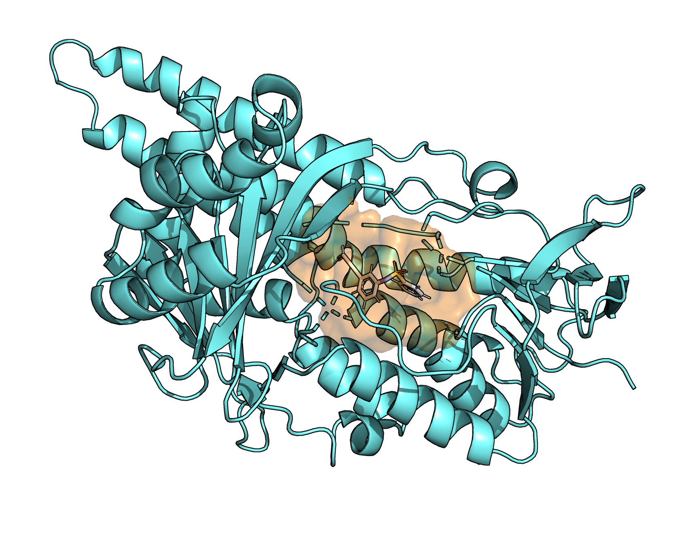
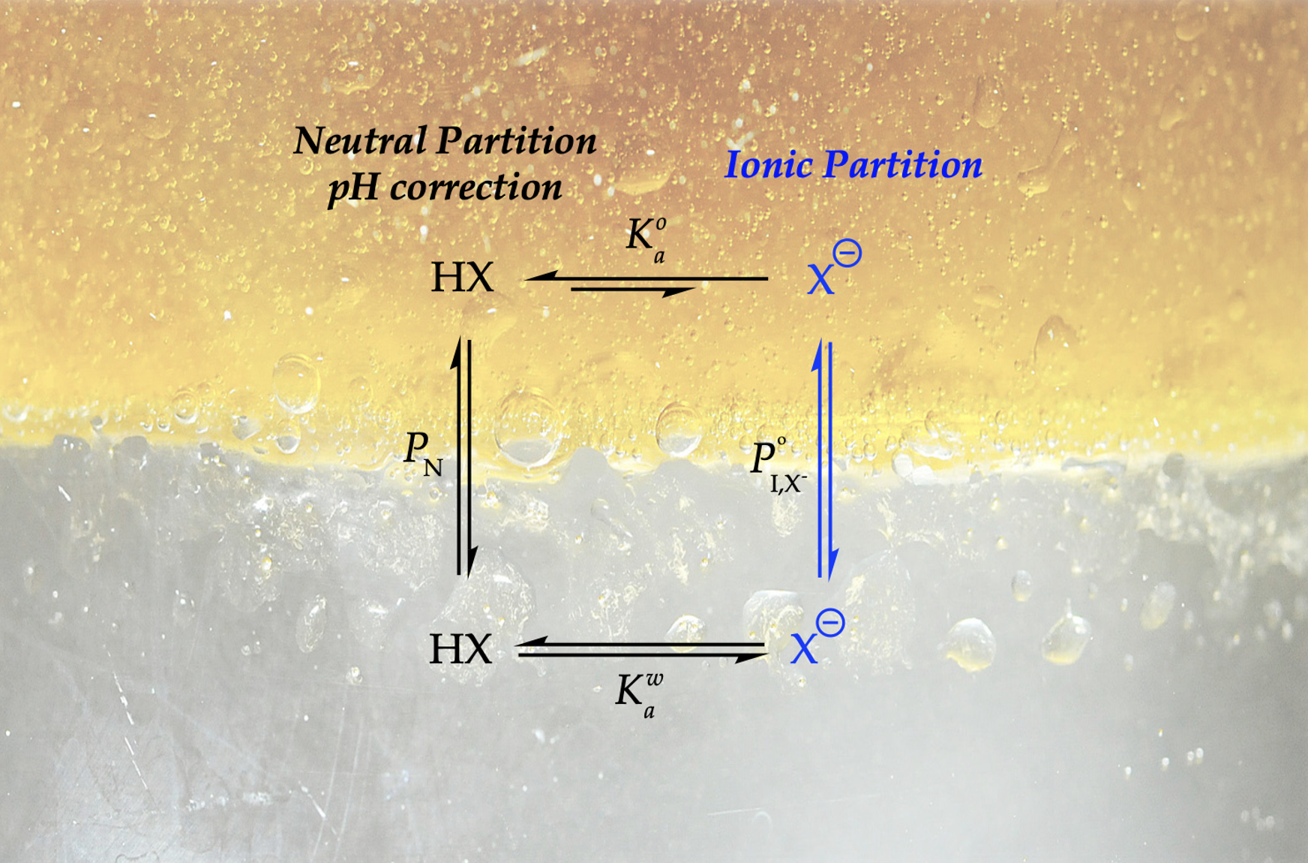

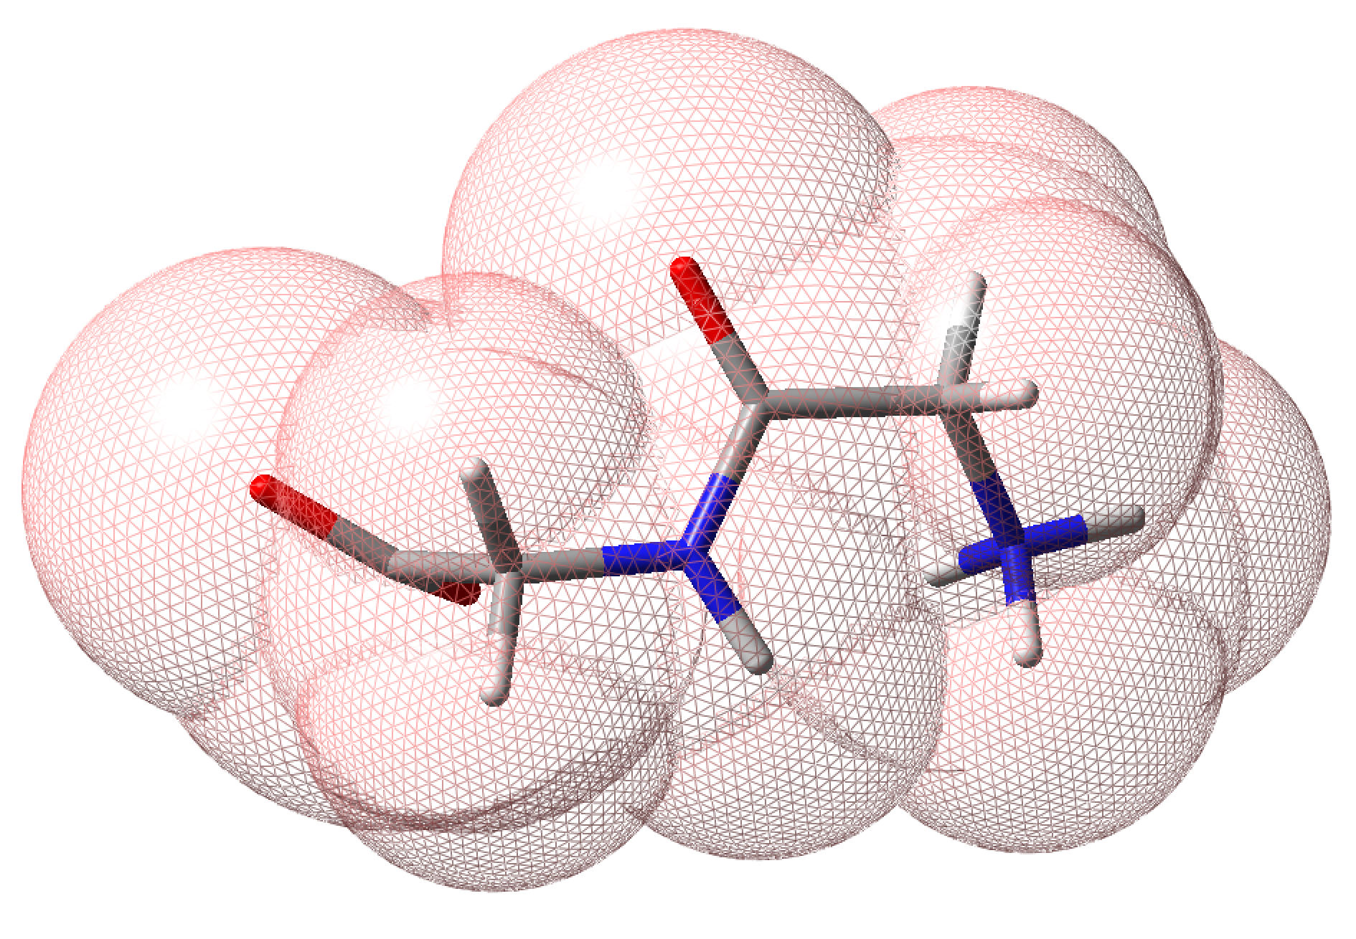
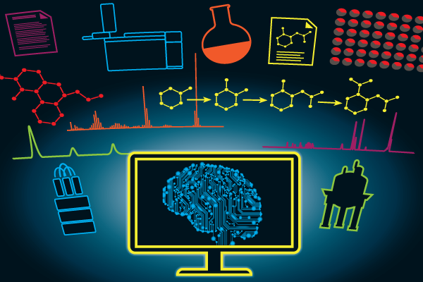
Computational Biology
Drug Design
Computational Chemistry
Theoretical Chemistry
Machine Learning

Slide 2
COMPUTATIONAL BIOPHYSICS, BIOLOGY & BIOINFORMATICS GROUP
Computational Biology
Machine Learning
& Drug Design
Computational Chemistry
Theoretical Chemistry

Slide 3
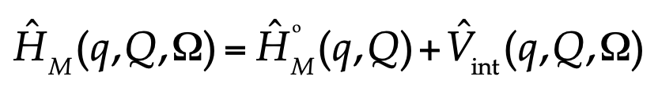
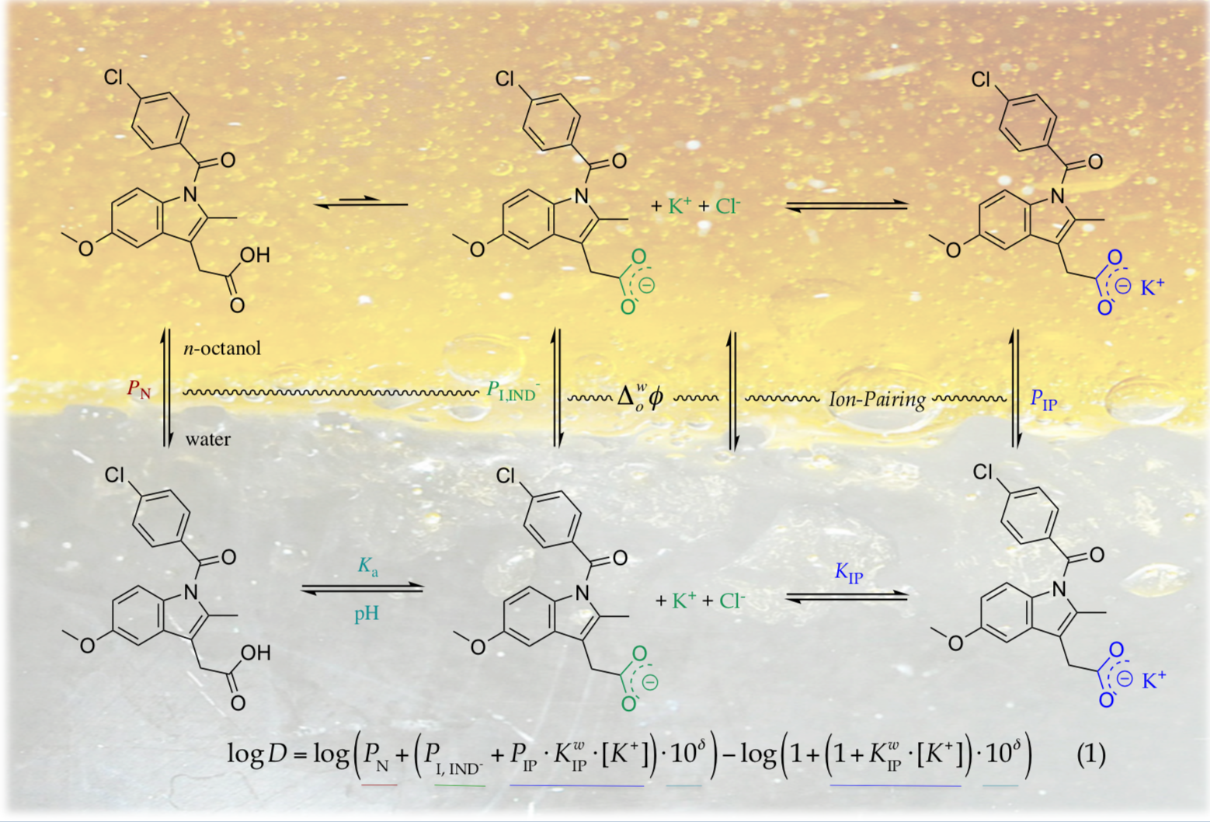
Computational Chemistry
Computational Biology & Drug Design
Machine Learning
Theoretical Chemistry

Slide 4
Computational Biology & Drug Design
Computational Chemistry
Theoretical Chemistry
Machine Learning

Slide 5
Computational Biology
Computational Chemistry
Drug Design
Theoretical Chemistry
Machine Learning

Slide 6
Computational Biology
Computational Chemistry
Drug Design
Theoretical Chemistry
Machine Learning

Slide 7
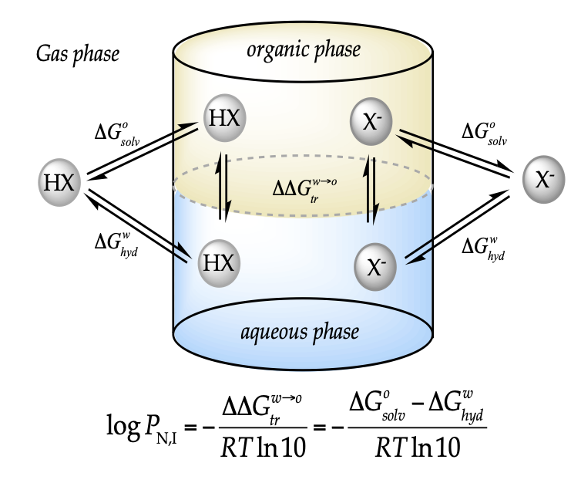
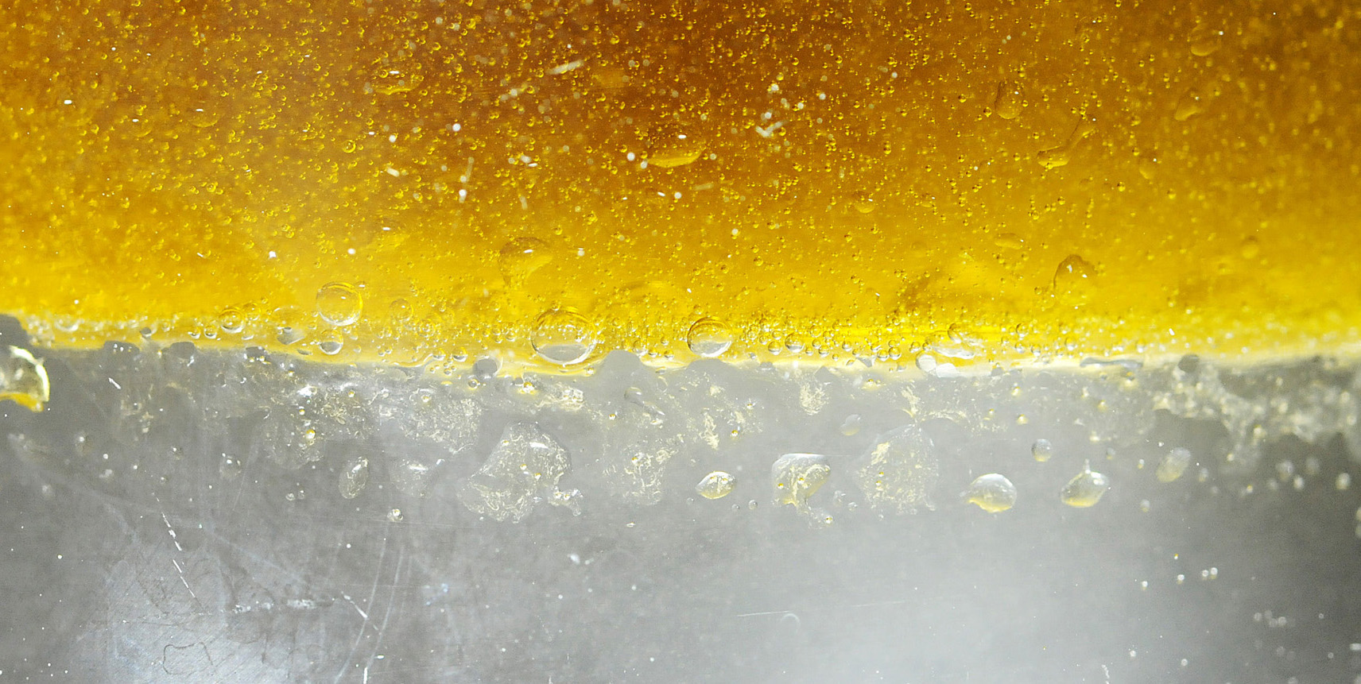

Neutral Partition
pH correction
Ionic Partition

Slide 8
